Slide 1
Devops Implementation
Azure Devops

Slide 2
What is DevOps
Develop
“
DevOps is the union of people, process, and products to enable continuous delivery of value to your end users.
”
DevOps
Operate
Deliver

Slide 3
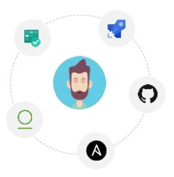
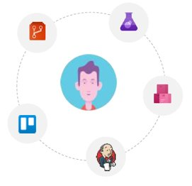
Why DevOps
Developer
Shorter Development Cycles, Faster Innovation​
Reduced Deployment Failures, Rollbacks, and Time to Recover​
Improved Communication and Collaboration​
Increased Efficiencies​
Reduced Costs​
Lets Developer choose tools of their choice
Operation

Slide 4

CI/CD Pipeline
Continuous integration and continuous delivery (CI/CD) are considered by most to be the backbone of DevOps. Things start to get interesting when you combine these practices with programmable infrastructure and a suite of services that allow you to automate the entire lifecycle of an application.
The goal with this guide is to give you a practical example of what that all looks like when you’re building, testing, and deploying applications with Azure DevOps Services. I’ll walk you through the end-to-end process of building a fully automated build and release pipeline for a Node and Express application. We’ll use Azure DevOps Services to create the CI/CD pipeline and Azure App Service for deploying to development/staging and production.

Slide 5
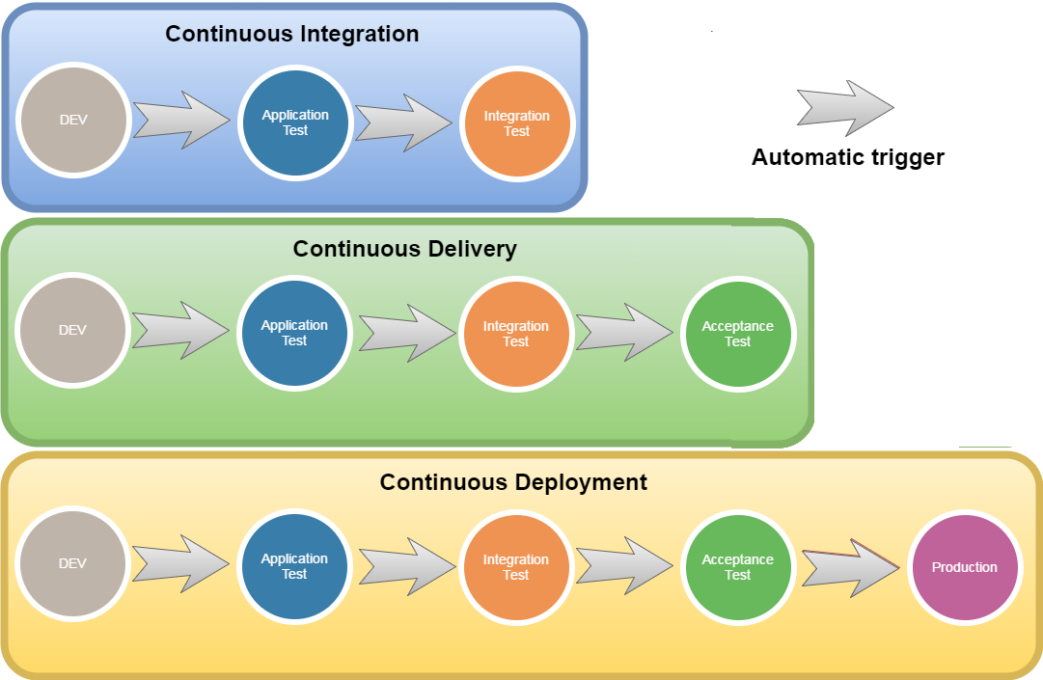

CI CD LifeCycle

Slide 6
Technical Solution
Introducing Azure DevOps

Slide 7
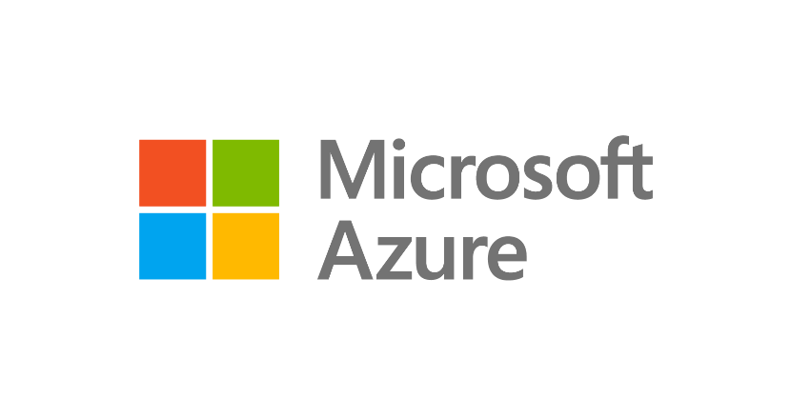
Develop
GitHub
Visual Studio
Visual Studio Code
Innovate at scale.
Deliver with confidence.
Microsoft Azure Devops service is the cloud Based platform with DevOps tooling built in
Operate
Deliver
Azure Monitor
Azure Policy
Azure Automation
Azure Security Center
Azure Boards
Azure Repos
Azure Pipelines
Azure Artifacts
Azure Test Plans
Azure Lab Services
Notes:
So, we’ve just run through our overall solution and how this addresses all four areas that enable you to innovate at scale, and deliver with confidence. We looked at how you can use:
Visual Studio and Visual Studio code to maximize developer efficiency
GitHub to accelerate collaboration and open source development practices
Azure DevOps to accelerate delivery of your products and
Azure Security & Management services to ensure your products operate reliably, scale and remain secure

Slide 8
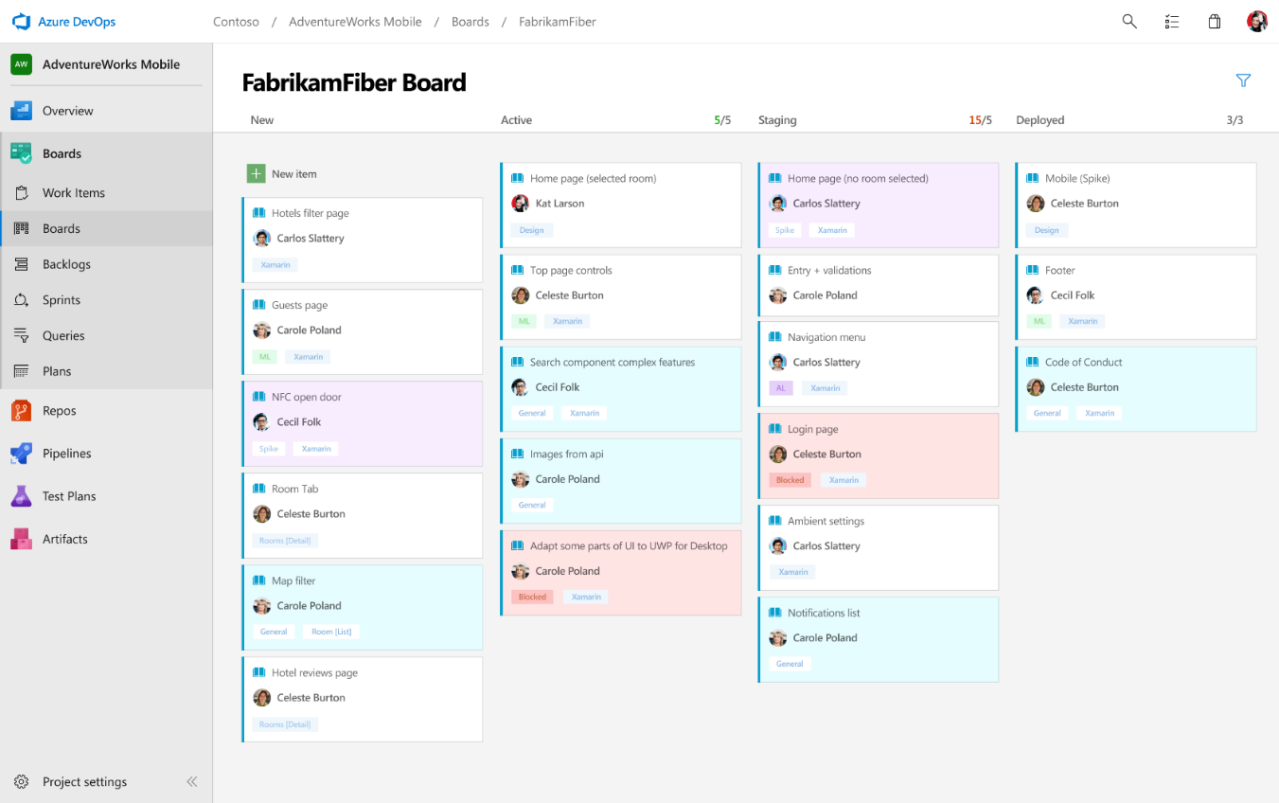




Deliver
Azure Boards
Azure Repos
Azure Pipelines
Deliver value to your users faster using proven agile tools to plan, track, and discuss work across your teams.
Feature: * Product Backlog Management​ * Prioritized Spring Backlog​ * Release Planning ​ * Manages Team Collaboration​ * Manage Scrum Velocity​ * Manages Teams Capacity
Azure Artifacts
Azure Test Plans

Slide 9
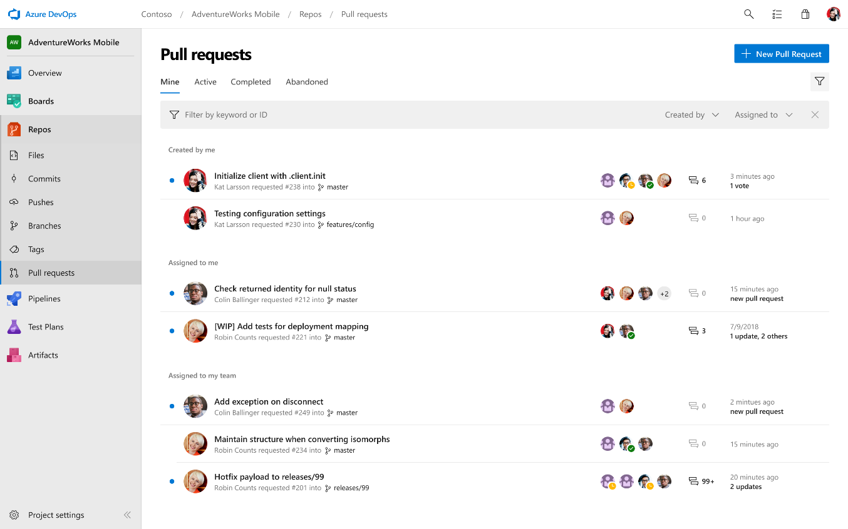
Deliver
Azure Boards
Azure Repos
Azure Pipelines
Azure Repos is a set of version control tools that you can use to manage your code.​
Azure Repos provides two types of version control:​
Git: distributed version control​
Team Foundation Version Control (TFVC): centralized version control​
Git in Azure Repos is standard Git. You can use the clients and tools of your choice, such as Git for Windows, Mac, partners' Git services, and tools such as Visual Studio and Visual Studio Code.​
Manage Your Branches ​
Main Branch​
Release Branch​
Merging, Push / Pull Strategy​
Branching Policies & Permissions
Azure Artifacts
Azure Test Plans

Slide 10
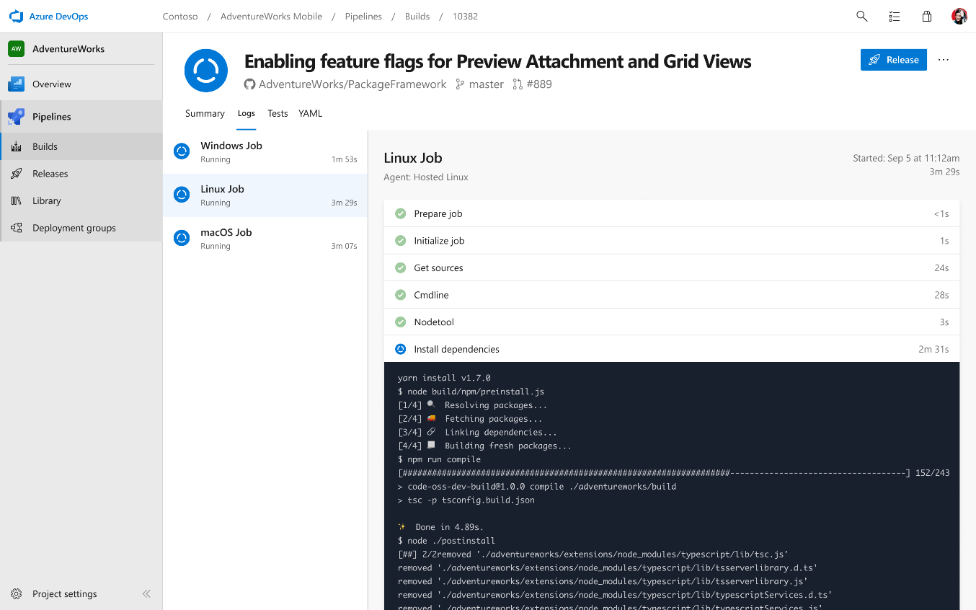
Deliver
Azure Boards
Azure Repos
​Azure Pipelines is a fully featured continuous integration (CI) and continuous delivery (CD) service. It works with your preferred Git provider and can deploy to most major cloud services. Feature: * Cloud-hosted pipelines for Linux, macOS and Windows​ * Any language, any platform, any cloud​ * Native support for containers and Kubernetes​ * Best-in-class for open source​
Azure Pipelines
Azure Artifacts
Azure Test Plans

Slide 11
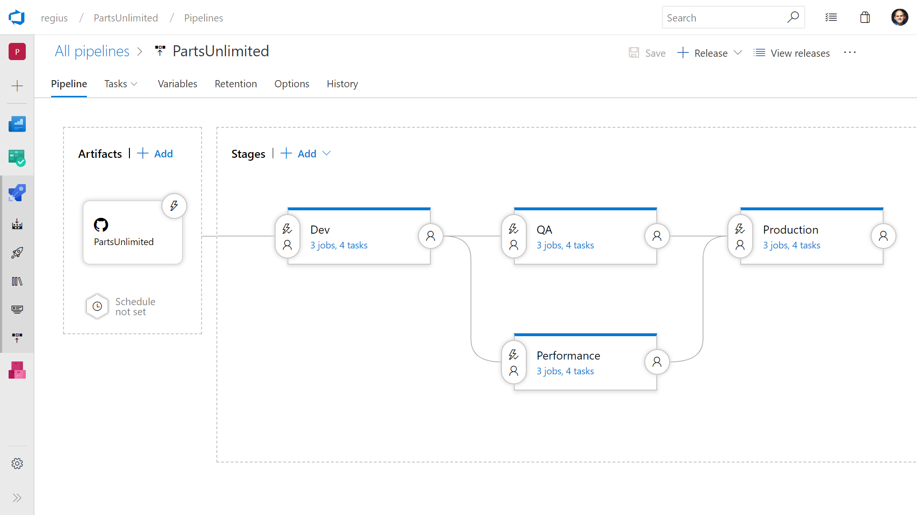
Deliver
Azure Boards
Azure Repos
Azure Pipelines
* Deploy to on-premises, ANY cloud or a hybrid of cloud and on-premise
* Staged environment releases
* Pre and post deployment approvals with gates to automate approval based on conditions
Azure Artifacts
Azure Test Plans

Slide 12
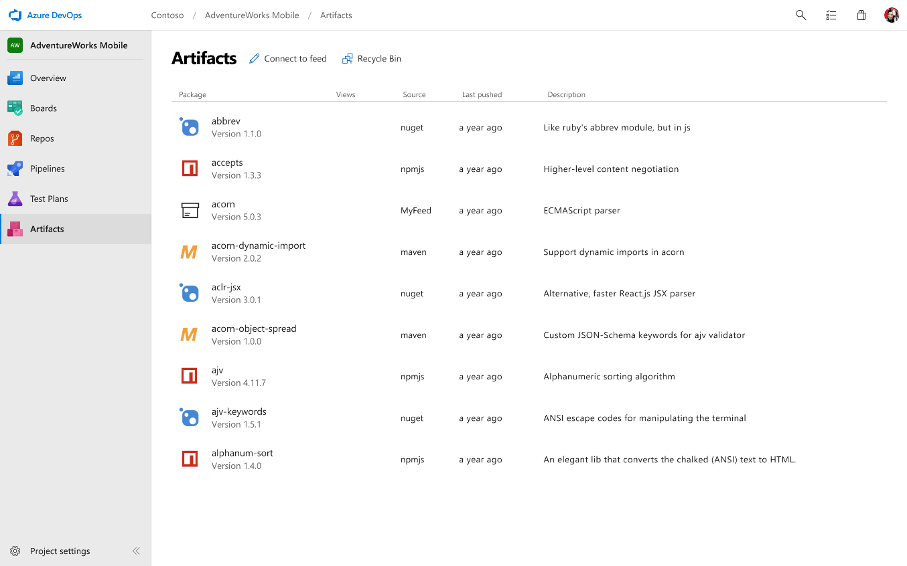
Deliver
Azure Boards
Azure Repos
Azure Pipelines
Keep your Maven, npm, NuGet and Python packages and more in the same place​
Share packages, and use built-in CI/CD, versioning, and testing.​
​Easily share code across small teams and large enterprises.
Azure Artifacts
Azure Test Plans

Slide 13
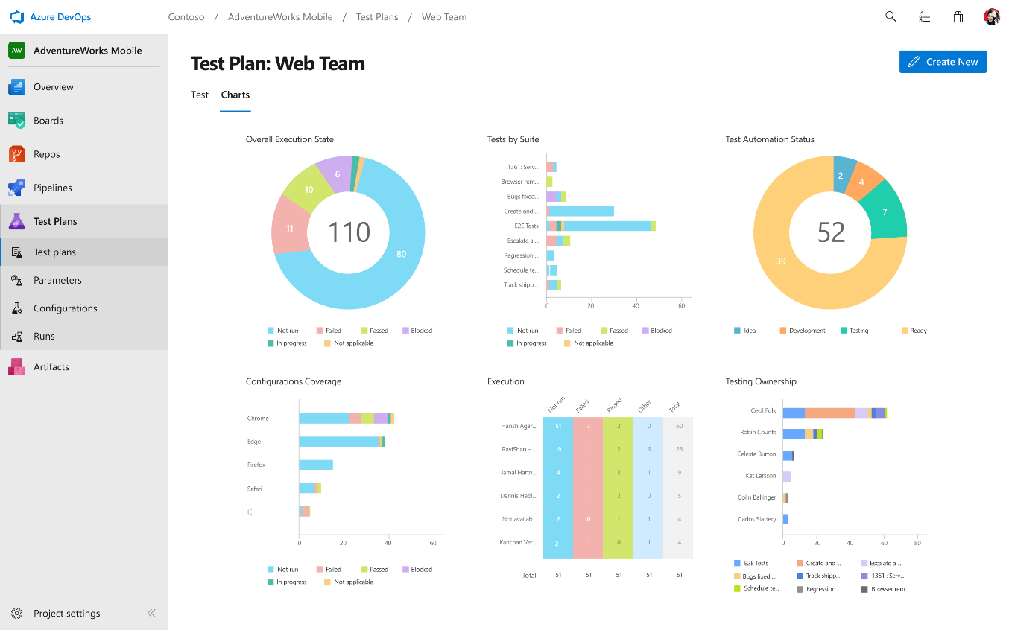
Deliver
Azure Boards
Azure Repos
Azure Pipelines
Azure DevOps Test Plan provides all the tools you need to successfully test your applications. Create and run manual test plans, generate automated tests and collect feedback from users.
Features: Run tests and log defects from your browser​
Track and assess quality throughout your lifecycle​
Capture rich data for reproducibility​
Create tests directly from exploratory sessions
Azure Artifacts
Azure Test Plans

Slide 14
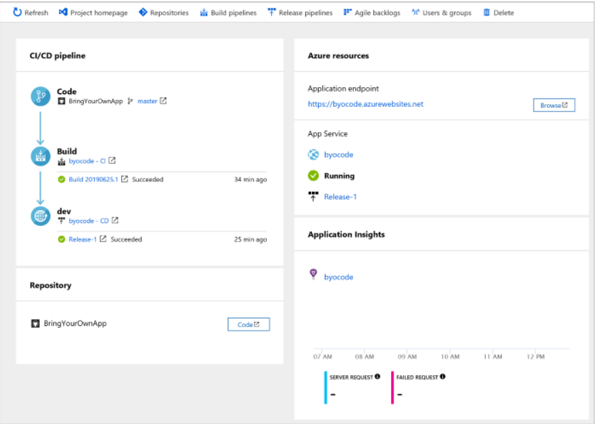
How Pipeline Looks in Azure DevOps

Slide 15
Costing
Let's calculate the cost defined by Microsoft based on user count:-
https://azure.microsoft.com/en-us/pricing/details/devops/azure-devops-services/

